Slide 1
Leadership GPS
Neuroleadership: An Introduction to Cognitive Bias
August 25, 2022
VADM Lou Crenshaw, USN(Ret.)
#DCPASExcellence

Slide 2
Human Brain
Brain Stem (Avoiding Harm)
Survival functions
Energizes and guides behavior
Sub Cortex (Approaching Rewards)
Middle of head
Center of emotions, motivation and primitive bonding
Cortex (Positive attachment)
Outer shell
Abstract reasoning
Reflecting about past and future
Key social abilities such as empathy, language and cooperative planning
Integration of experience, reflection
2

Slide 3
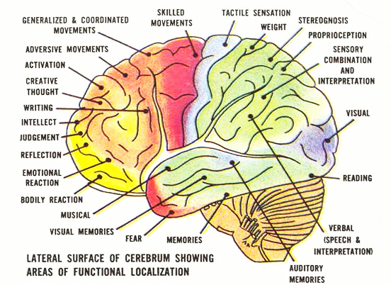
Human Brain
3

Slide 4
Brain Development
Pre-frontal cortex does not begin to “kick in” until we are about 18 months old
Until then we are operating for the most part on mid and lower brain functions
Language is key
Before 18 months we have only “implicit memory” for how things feel to us—mostly derived from the people around us, how they act, what they like or dislike and their anxiety
At 18-24 months we begin to see ourselves as separate and able to impact the world
Pre-frontal lobe is not fully developed until we are well into our 20s
Until then, much of our thought and action is “mimic” and designed to avoid punishment or gain reward
At this time we can operate, with intent, in higher levels of reasoning
4

Slide 5
Thinking Systems
System 1: Fast, intuitive and emotional. Little or no effort. Share this system with most other creatives on the planet. We are born equipped for this system. Usually easy, feels good. Operates all of the time in the background and alerts System 2 when it is needed. CANNOT BE TURNED OFF.
System 2: Slower, more deliberate and logical. Allocate attention to effortful mental activities including complex judgment and calculations. Associated with agency, choice and concentration. Probably more evolved than many other creatures. More work, more difficult. EASILY DISTRACTED. SUBJECT TO WILLPOWER AND ENDURANCE.
Source: Thinking Fast and Slow, Kahneman
5

Slide 6
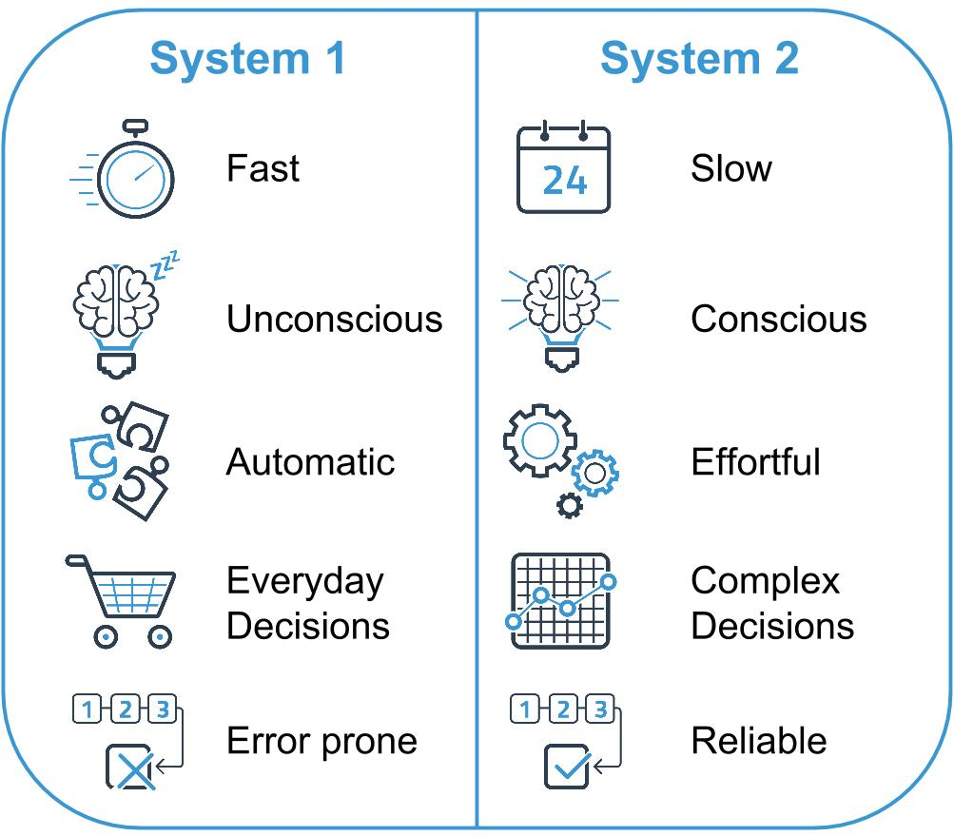
Thinking Systems
6

Slide 7
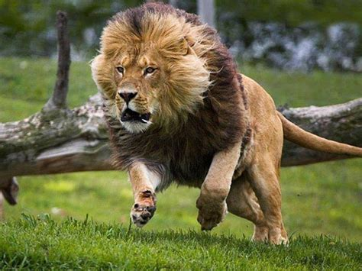
Thinking System One
7

Slide 8
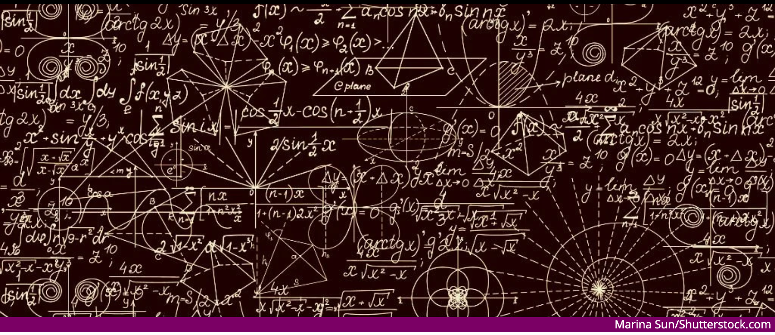
Thinking System Two
8

Slide 9
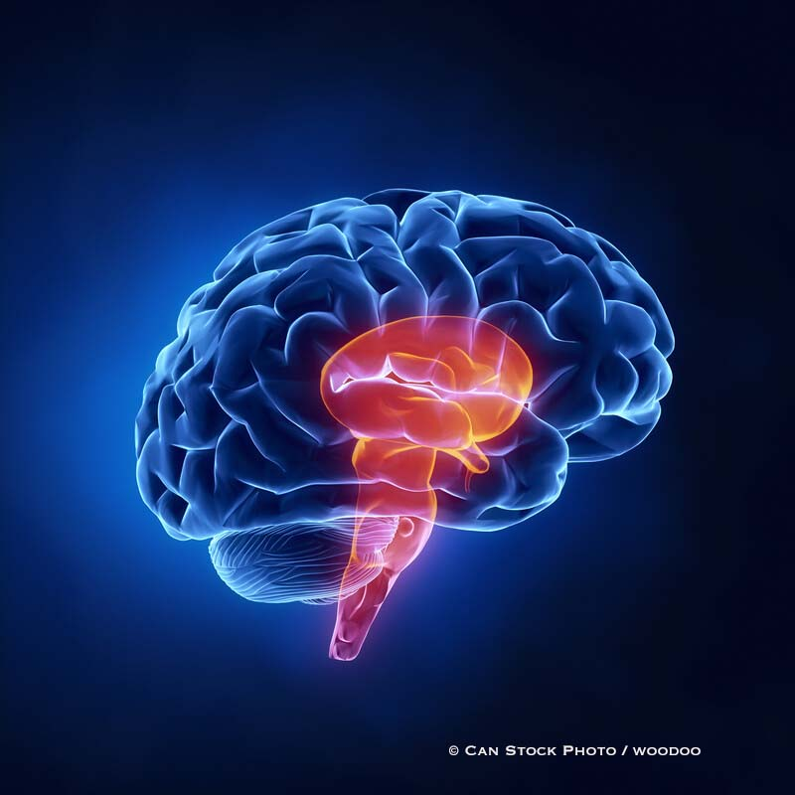
System One and Two Examples
System One
System Two
Detect an object more distant than another
Orient to source of sudden sound
Complete the phrase “Bread and …..”
Detect hostility in a voice
Answer 2 + 2
Drive a car on an empty road
Make ”disgust face” when shown a horrible picture
Park in an empty parking lot
Brace for starter gun in a race
Focus on the clowns in a circus
Focus on a particular voice in a crowded room
Look for a woman with white hair
Monitor your behavior in a social situation
Tell someone your phone number
Park in a narrow space
Compare ratings on Amazon when making a purchase
9

Slide 10
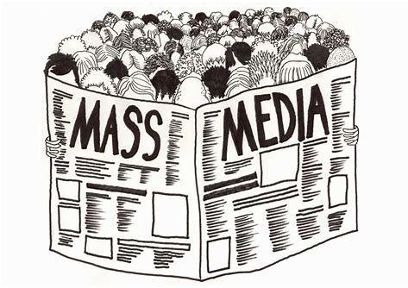
System One Develops From..
10

Slide 11
System One and Two Activity
Use chat to post your thoughts
In what ways do we use System 1 and System 2 thinking in the workplace? What are the pros and cons?
Can you think of times when we should use one instead of the other?
11

Slide 12
The Problem
Why don’t we just use System 2 all the time?
12

Slide 13
System 1 and System 2 as a Team
The division of labor between System 1 and System 2 is highly efficient: it minimizes effort and optimizes performance….AND
System 1 has errors that is prone to make in certain circumstances which leads to…
Source: Kahneman, Daniel, https://www.scientificamerican.com/article/kahneman-excerpt-thinking-fast-and-slow/
13

Slide 14
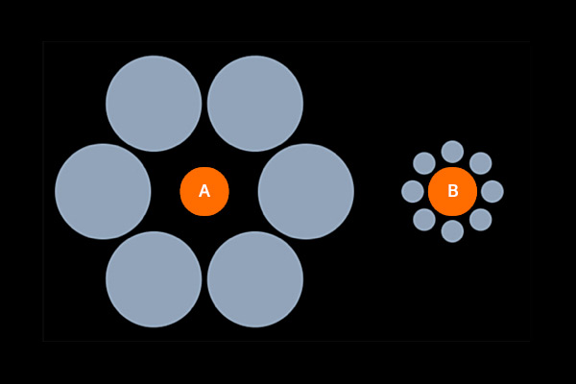
Cognitive Bias
A cognitive bias is a tendency to make repeated and similar mistakes in thinking. Unlike random errors, which have no pattern, these mistakes are systematically wrong in one direction. They usually arise from simple rules-of-thumb, or heuristics, which the mind uses to help it to perform a task more easily.
As an example, the diagram illustrates the Ebbinghaus Illusion – the orange circle on the right (B) appears, to most people, larger than the orange circle on the left (A). In fact, they are the same size. The heuristic involved here is to take the context into account, when estimating the size of things. The bias is to usually overestimate the size of objects, when smaller ones surround them – and underestimate the size of objects surrounded by larger ones
14

Slide 15
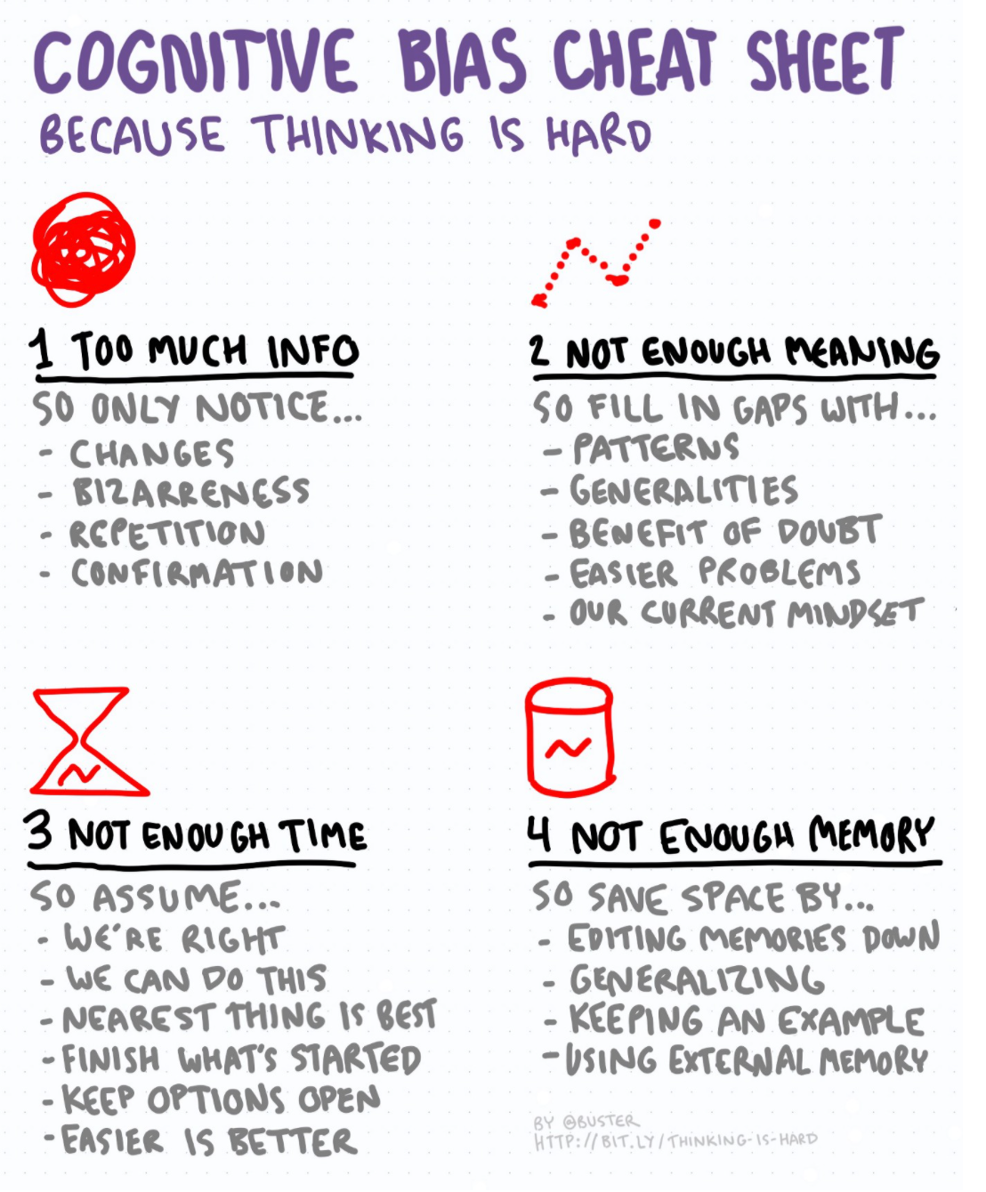
Cognitive Bias Cheat Sheet
15

Slide 16
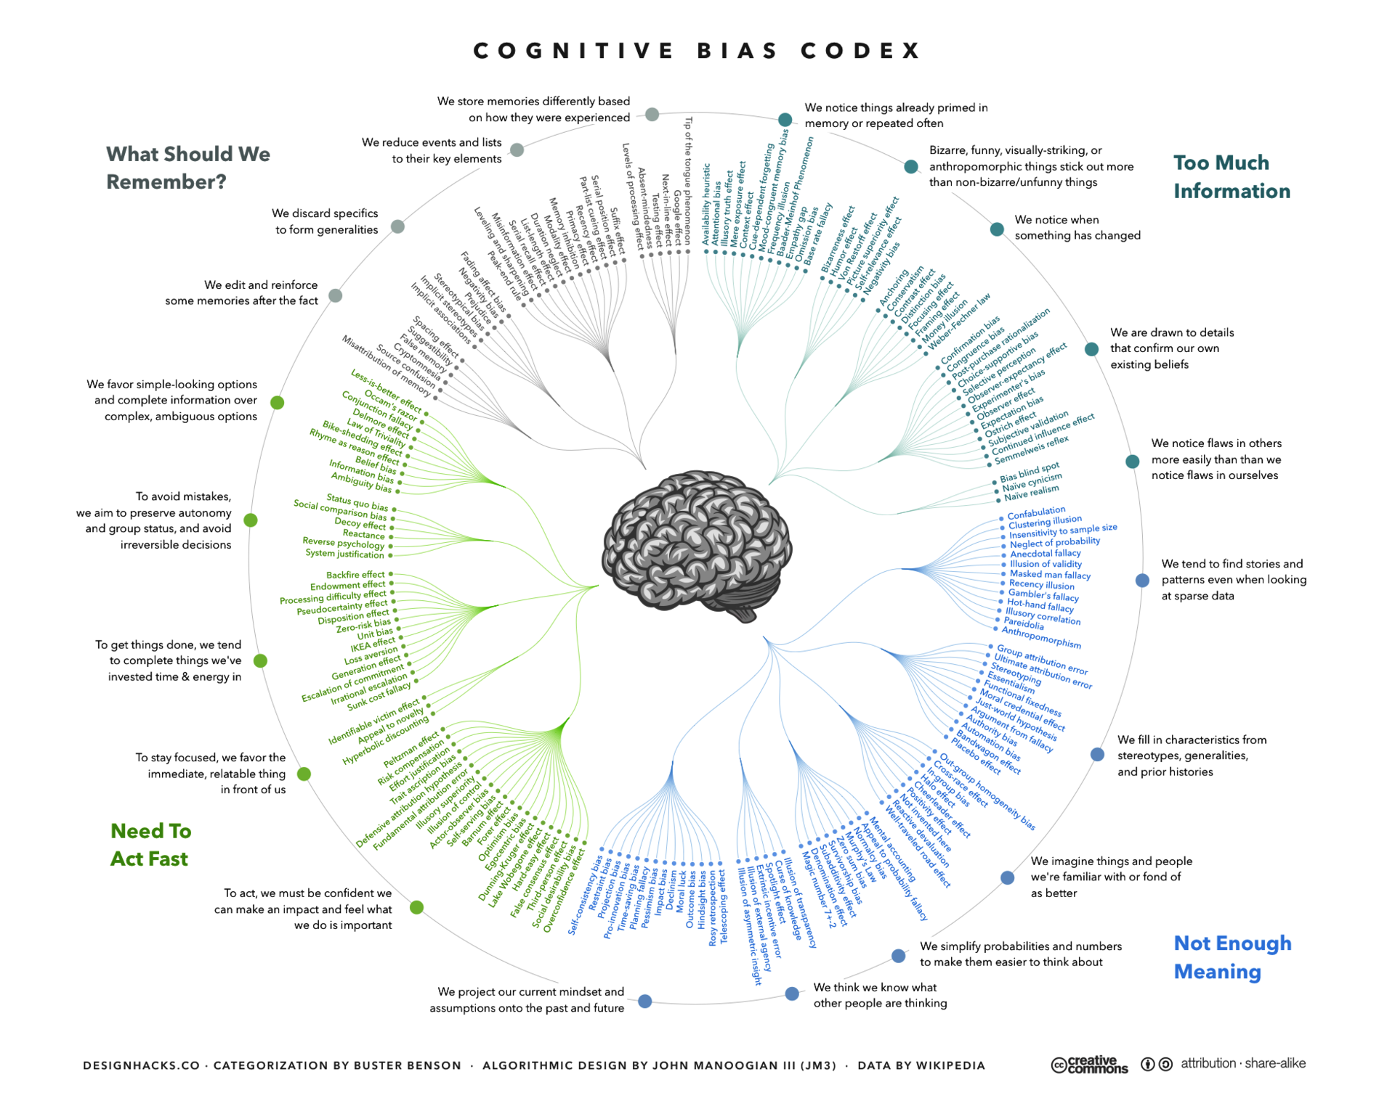
Thinking Traps
16

Slide 17
System One Thinking “Traps”
Law of Small Numbers
Characteristics of a sample population can be estimated from a small number of data points or observations.
Anchoring
Rely too heavily on the first piece of information when making decisions.
Availability
Overestimate frequency of events based on a memorable or dramatic occurrence.
Representativeness
Taking a few traits and overgeneralizing into a stereotype.
Primacy and Recency
Tendency to recall items the beginning or end of a list or sequence or event.
Confirmation bias
Tendency to look for confirming evidence of already held beliefs
Herd Mentality
Irrational agreement with no factual basis
17

Slide 18
System One Thinking “Traps”
Overconfidence
False sense of skill
Self-serving
Attribute positive outcomes to skill; negative outcomes to chance
Framing
Decisions based on the way the data is presented rather than the facts
Hindsight
When outcomes are correctly predicted, the incorrect notion of “I knew that all along”
Actor-Observer
Our bad outcomes explained by external forces. Their bad outcomes explained by internal forces
Optimism
Overestimating effects of good things, unestimating the effects of bad things
18

Slide 19
Mitigation Strategies
Schedule important decision meetings early in the day
Focus on the downsides
Take “extraordinary” measures when you know there is/has been systematic bias.
For strategic decisions have a group of diverse thinkers take the “opposite” position.
Actively check for cognitive bias—consider having a person be the “bias” monitor.
Create a list of your most common cognitive bias and check them when making a decision.
Give yourself a check list:
What could be another approach to a problem?
What are the upsides and downsides of each approach?
What are risks? Rewards?
19

Slide 20
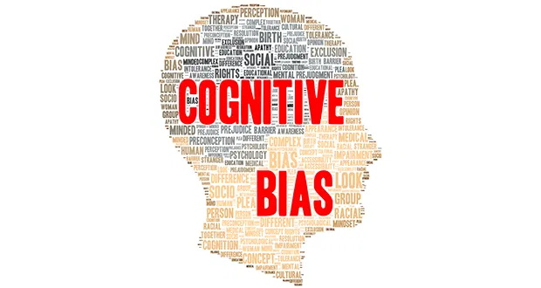
Reflection
Image Source:
https://minnlawyer.com/2018/03/01/awareness-of-cognitive-bias-can-improve-advocacy/
20

