Slide 1
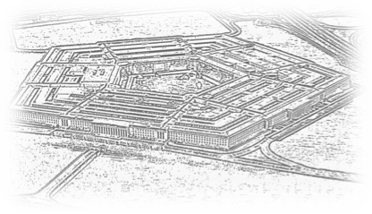
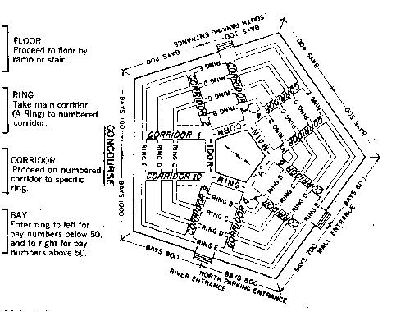
NAV 101: Navigating DoD
GovConectx
Doing Business With DOD
December 12, 2023
VADM Lou Crenshaw USN (Ret.)
Crenshaw Consulting Associates

Slide 2
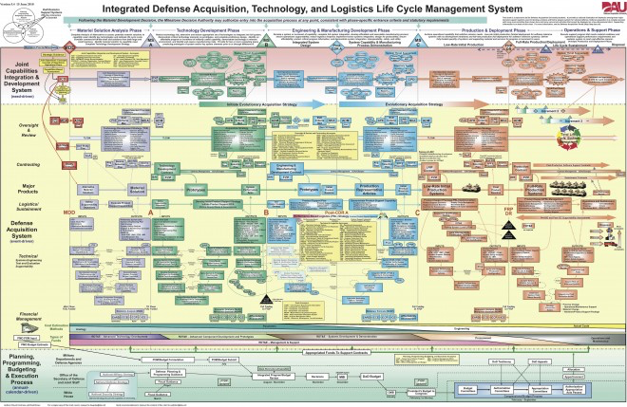
But First . . . . .

Slide 3
Finding Opportunities
WWW.SAM.gov
Formerly Fed Biz Ops
Federal Procurement Data System (FPDS)
USASpending.gov
Procurement Technical Assistance Centers (PTAC)
VA: https://virginiaptac.org
MD: https://www.marylandapex.org
Search Service
GovWin
Bgov.com (Bloomberg Government)
Fedmine
BidNet
GovTribe
FedBidSpeed
Small Business Administration (https://www.sba.gov/federal-contracting)
Individual Small Business Offices (almost all have list of upcoming RFPs).
© Can Stock Photo / kbuntu

Slide 4
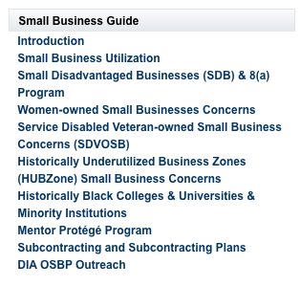
Use Agency Small Business Offices

Slide 5
Contract Vehicles
GSA Schedule
Which one?
EIN, DUNS, UEI(Unique Identity ID), SAMS, Open Ratings (6 min)
Respond
Credit Card/Micro Purchase ($10K)
SBIR/STTR
8(a), SDVOSB, WOSB, etc
Other Transaction Authority
At least one non-traditional DoD Contractor
All Small
Cost Sharing arrangement
See http://tinyurl.com/y3km2ayn

Slide 6
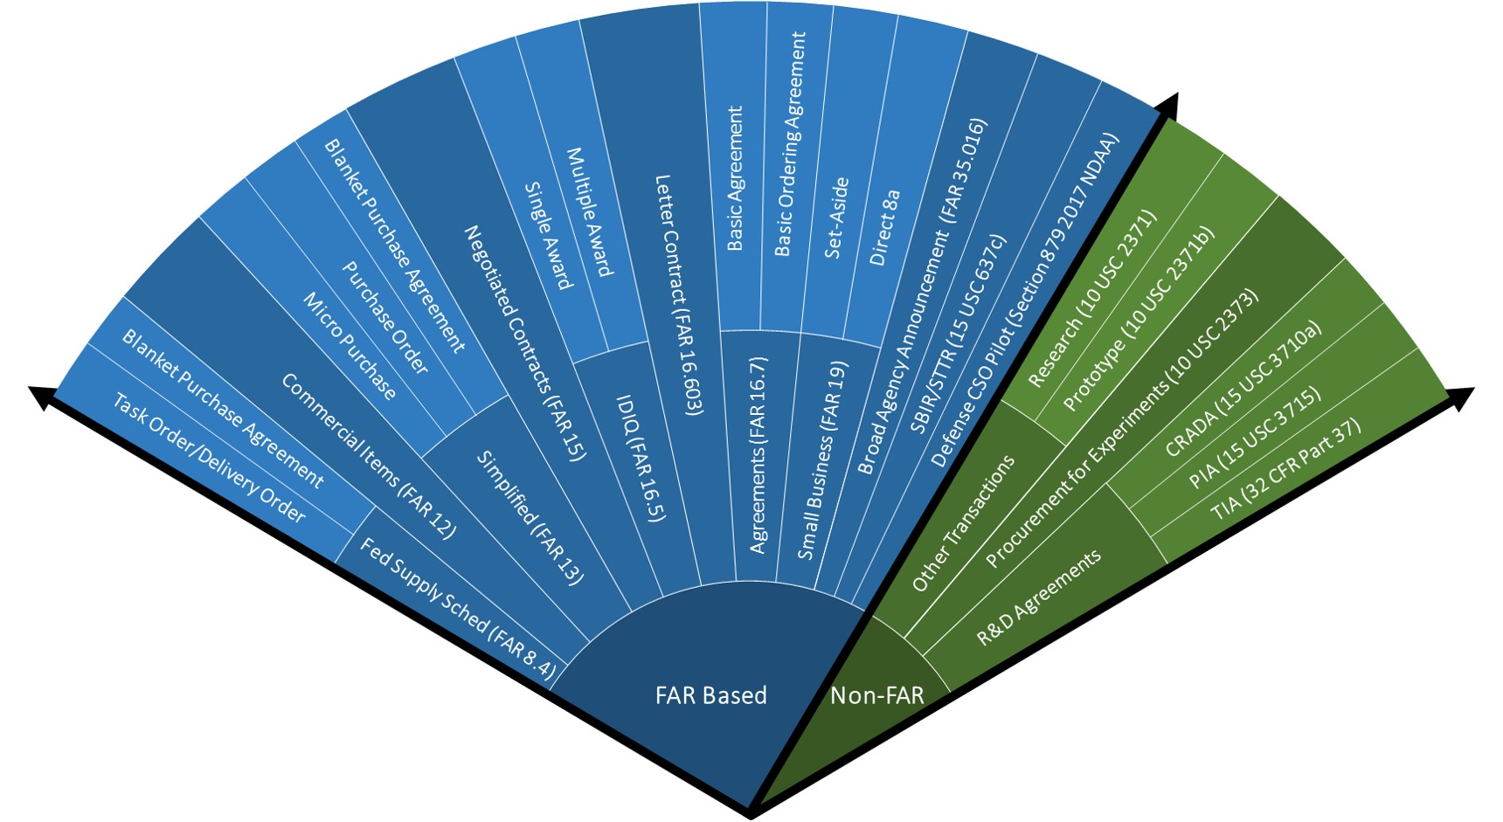
Contracting Cone
Source:
https://aaf.dau.mil/contracting-cone/

Slide 7
Other Transaction Authority
Must “..directly relevant to enhancing the mission effectiveness of military personnel and the supporting platforms, systems, components, or materials proposed to be acquired or developed by the Department of Defense, or to improvement of platforms, systems, components, or materials in use by the armed forces..”
At least one “non-traditional” defense contractor. “an entity that is not currently performing and has not performed, for at least the one-year period preceding the solicitation of sources by DoD for the procurement or transaction, any contract or subcontract for DoD”
Small business participation required.

Slide 8
Continuing Resolutions
Used when one or more of required 12 Appropriations Bills not passed
Usually used as a bridge to regular appropriated funds (122 in past 25 years)
Agencies allowed to spend at same rate on existing programs from previous year or spend a pro rated amount
Prohibits an agency from initiating or resuming any project or activity for which funds were not available in the previous fiscal year
For DoD, expressly prohibits:
starting production on a program that was not funded in prior years (i.e., a new start)
from increasing production rates above previous years
Based on “color of money” not programs
Congress can include specific instructions on specific programs
Can cause problems with multi-year appropriations (R&D, Shipbuilding)
Current CR good for DoD until COB February 2, 2024.

Slide 9
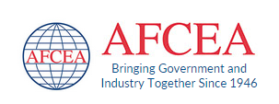
Join a Professional Organization

Slide 10
Find A Partner
Joint a team- Leverage your unique capabilities
Mentor-Protegé Program- Contact dodmpp@osd.mil
Contractor Teaming Arrangement (CTA)- FAR Subpart 9.6
Joint Venture- FAR Subpart 19.14(Rules about SDVOSBs)
Consortiums
Contractor Teaming Arrangement

Slide 11
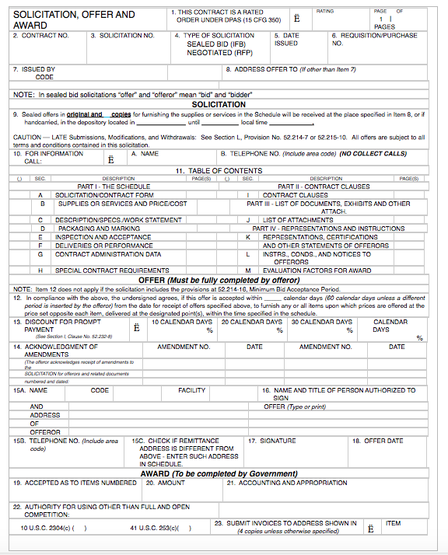
Read the RFPs Carefully
Use all the options
Don’t over deliver
Answer all the questions
Don’t waste words
Demonstrate understanding
Review all the FAR paragraph cites in Section I
Focus on people skills, not people
Always, Always get a debrief

Slide 12
Watch Out!!!

Slide 13
Watch Out!!!
Unhappy COs
Where’s my deliverable?

Slide 14
Watch Out!!!
Timekeeping
Expenses

Slide 15
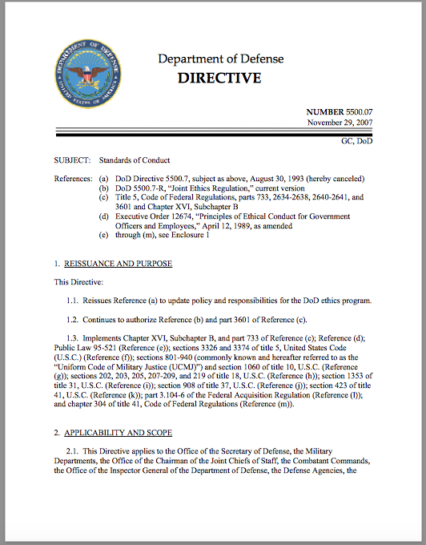
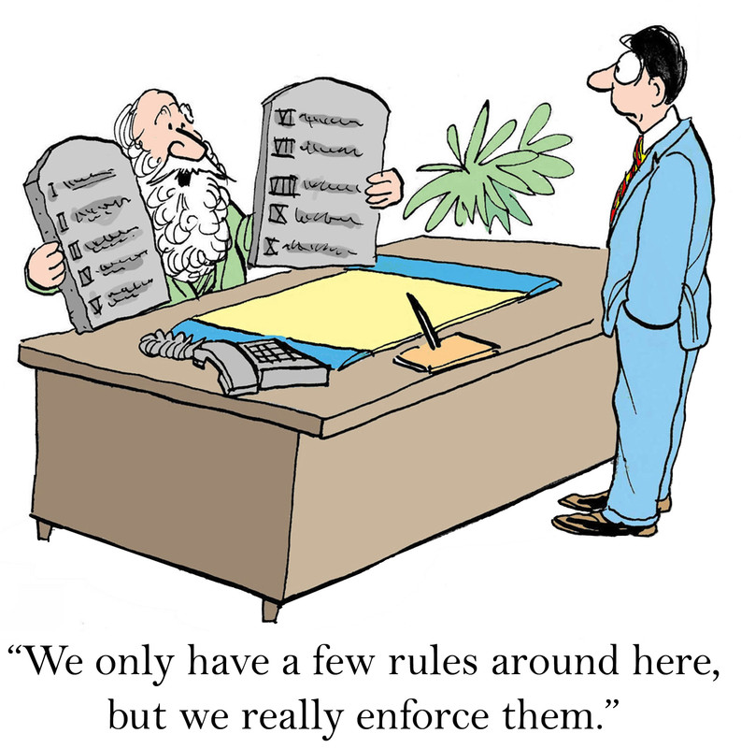
Ethics

Slide 16
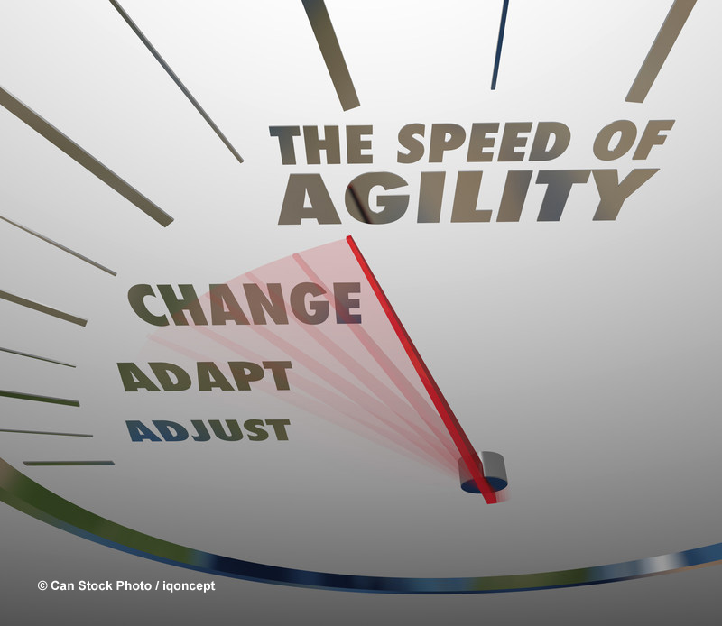
Be Prepared
Funding uncertainty
Holidays
Stop Work Orders
Protests
Reorganizations
TFTCOG
Long waits for clearances
COB before Holidays
Time to develop relationships
Shifting priorities
Beware of “contractapation”

Slide 17
What About COVID?
In-Person meetings in Pentagon returning to normal
Send advance copy of brief
Have your “Elevator Pitch” perfected
Have a clean, crisp, one-page summary
Zoom, GoToMeeting, Facetime, Adobe Connect not used
DoD uses mostly TEAMS

Slide 18
What About the 2024 Budget?
$842 Billion Request for DoD
PRC is the pacing threat
Deter strategic attack
Deter aggression
Build resilient joint force and Defense ecosystem
Key areas: Data Analytics, Audit, AI
2024 NDAA vote this week
$886 Billion authorized
No Chinese Batteries
Defers Space National Guard
5.2% pay raise
DoD CR Funding through Feb 2nd
Debt Ceiling suspended until Jan 1, 2024

Slide 19
Questions

