Slide 1
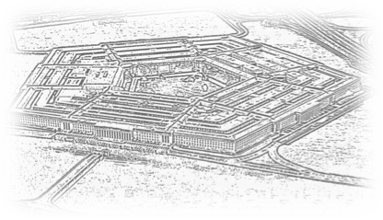
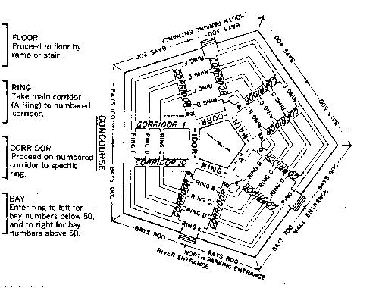
NAV 101: Navigating DoD
GovConectx
Doing Business With DOD
February 20, 20025
VADM Lou Crenshaw USN (Ret.)
Crenshaw Consulting Associates

Slide 2
Finding Opportunities
WWW.SAM.gov
Formerly Fed Biz Ops
Federal Procurement Data System (FPDS)
USASpending.gov
Procurement Technical Assistance Centers (PTAC)
VA: https://virginiaptac.org
MD: https://www.marylandapex.org
Search Service
GovWin
Bgov.com (Bloomberg Government)
Fedmine
BidNet
GovTribe
FedBidSpeed
Small Business Administration (https://www.sba.gov/federal-contracting)
Individual Small Business Offices (almost all have list of upcoming RFPs).
© Can Stock Photo / kbuntu

Slide 3
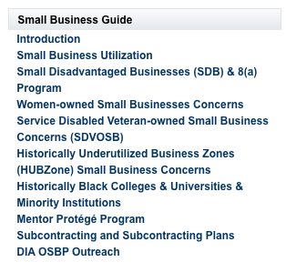
Use Agency Small Business Offices

Slide 4
Contract Vehicles
GSA Schedule
Which one?
EIN, DUNS, UEI(Unique Identity ID), SAMS, Open Ratings (6 min)
Respond
Credit Card/Micro Purchase ($10K)
SBIR/STTR
8(a), SDVOSB, WOSB, etc
Other Transaction Authority
At least one non-traditional DoD Contracto
Cost Sharing arrangement
See http://tinyurl.com/y3km2ayn

Slide 5
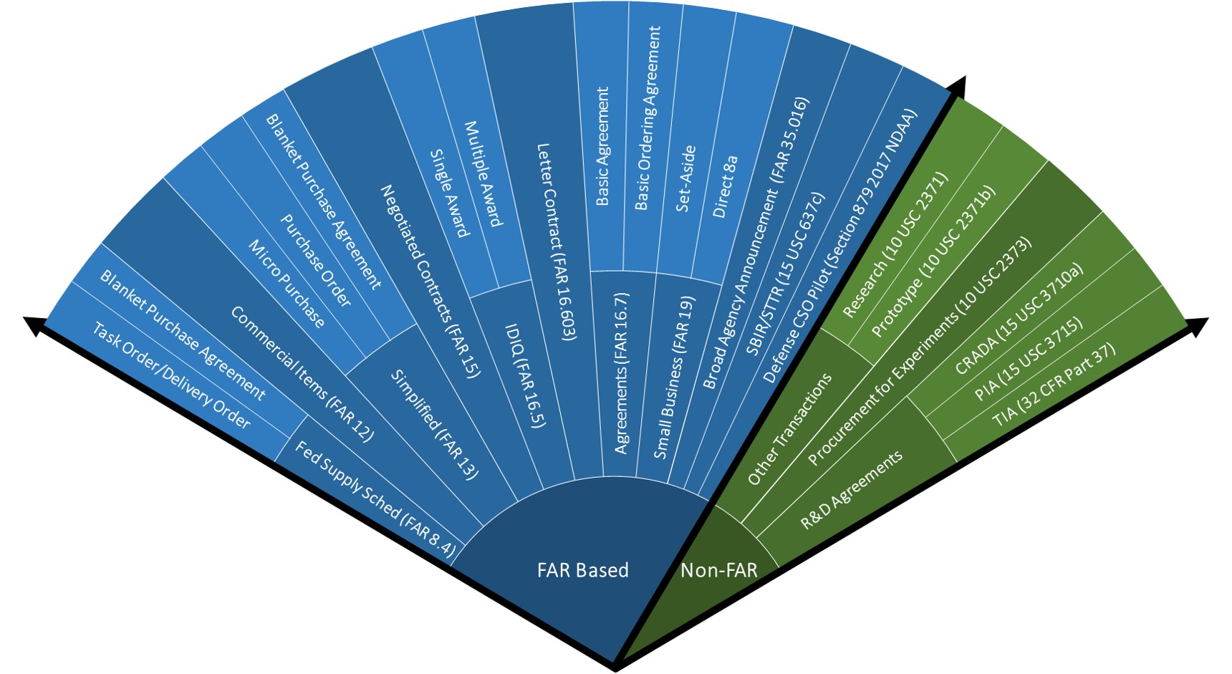
Contracting Cone
Source:
https://aaf.dau.mil/contracting-cone/

Slide 6
Other Transaction Authority
OTA is a flexible contracting mechanism used by U.S. federal agencies to accelerate research, development, and prototyping without the constraints of traditional Federal Acquisition Regulations (FAR)
Must “..directly relevant to enhancing the mission effectiveness of military personnel and the supporting platforms, systems, components, or materials proposed to be acquired or developed by the Department of Defense, or to improvement of platforms, systems, components, or materials in use by the armed forces..”
At least one “non-traditional” defense contractor. “an entity that is not currently performing and has not performed, for at least the one-year period preceding the solicitation of sources by DoD for the procurement or transaction, any contract or subcontract for DoD”
Small business participation encouraged, but no set-asides

Slide 7
Other Transaction Authority
Characteristics
Not bound by FAR
Types
Research
Prototype
Production
Innovation Focus
Streamlined Process
Flexible (IP, payments, Mgmt)
Common Uses
Cutting-edge Tech Development
Cybersecurity
AI and other Machine Learning
Space/Satellite Development
Biotechnology
Advanced Manufacturing
How
Consortia Participation
Direct Contracting
Subcontracting
Teaming
Small Business Benefits
Reduced Bureaucratic Burden
Faster Contract Timeline
Flexible/Negotiable Terms
Opens Door to Larger Projects

Slide 8
Continuing Resolutions
Used when one or more of required 12 Appropriations Bills not passed
Usually used as a bridge to regular appropriated funds (122 in past 25 years)
Agencies allowed to spend at same rate on existing programs from previous year or spend a pro rated amount
Prohibits an agency from initiating or resuming any project or activity for which funds were not available in the previous fiscal year
For DoD, expressly prohibits:
starting production on a program that was not funded in prior years (i.e., a new start)
from increasing production rates above previous years
Based on “color of money” not programs
Congress can include specific instructions on specific programs
Can cause problems with multi-year appropriations (R&D, Shipbuilding)
Current CR good for DoD until COB March 14, 2025.

Slide 9
Join a Professional Organization

Slide 10
Find A Partner
Joint a team- Leverage your unique capabilities
Mentor-Protegé Program- Contact dodmpp@osd.mil
Contractor Teaming Arrangement (CTA)- FAR Subpart 9.6
Joint Venture- FAR Subpart 19.14(Rules about SDVOSBs)
Consortium Participaton: Defense Industrial Base Consortium
Contractor Teaming Arrangement

Slide 11
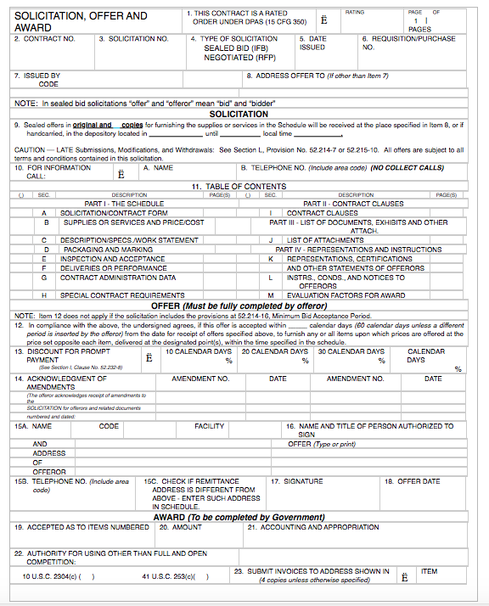
Read the RFPs Carefully
Use all the options
Don’t over deliver
Answer all the questions
Don’t waste words
Demonstrate understanding
Review all the FAR paragraph cites in Section I
Focus on people skills, not people
Always, Always get a debrief

Slide 12
Watch Out!!!

Slide 13
Watch Out!!!
Unhappy COs
Where’s my deliverable?

Slide 14
Watch Out!!!
Timekeeping
Expenses

Slide 15
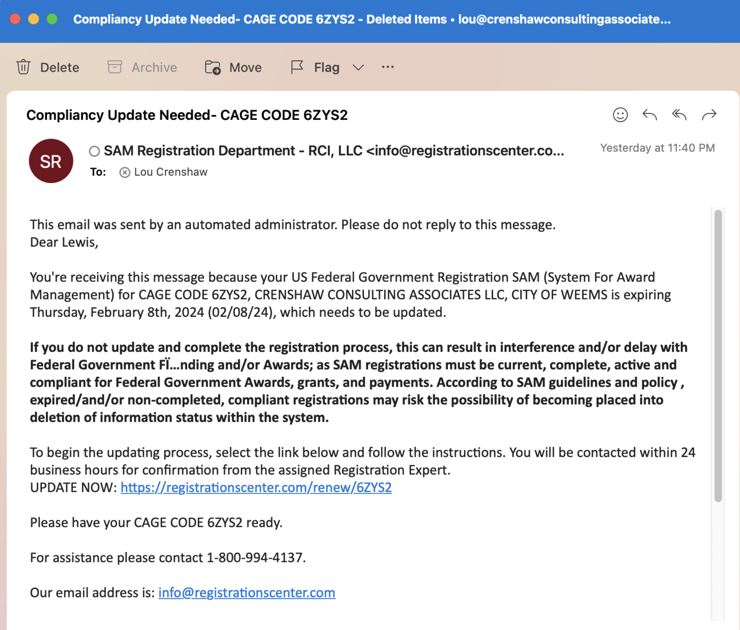
Watch Out!!!
Do not pay someone to manage your SAM Registgration

Slide 16
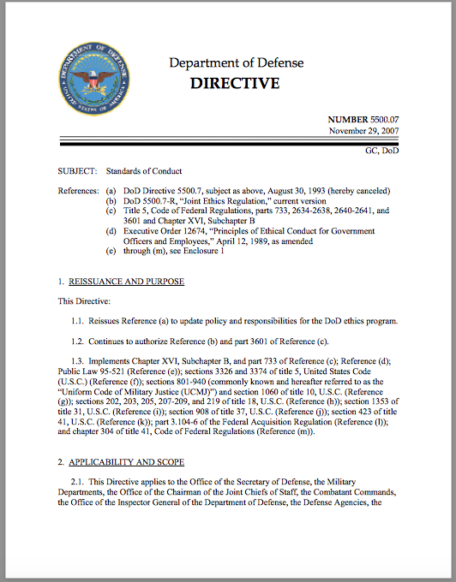
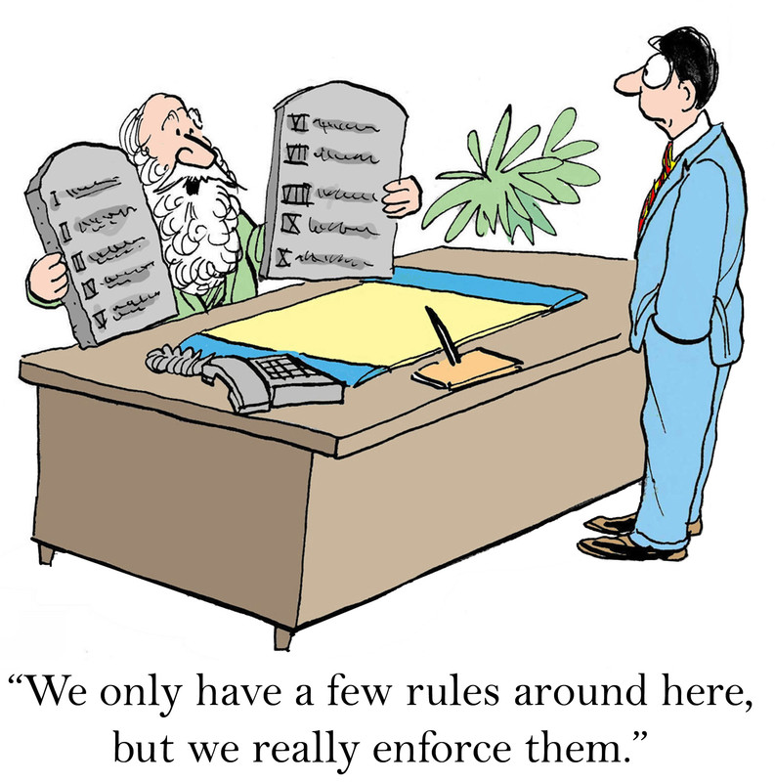
Ethics

Slide 17
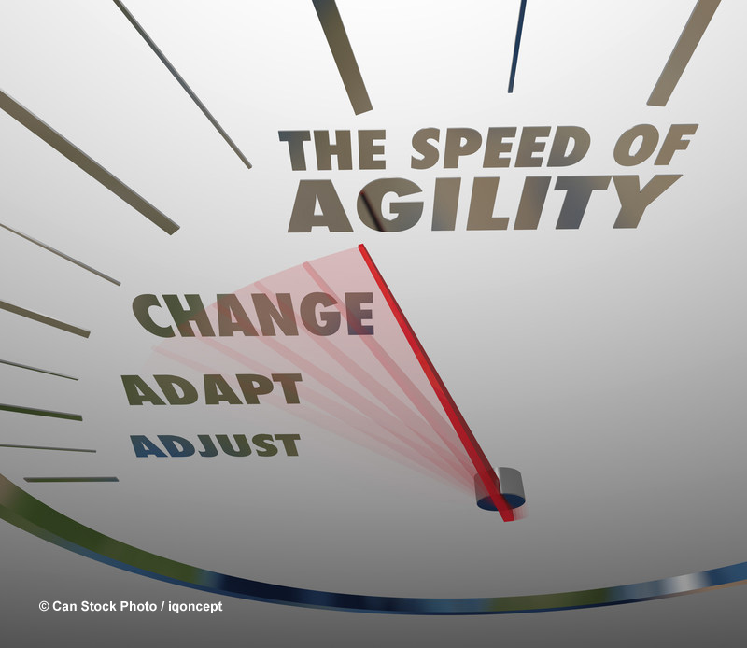
Be Prepared
Funding uncertainty
Holidays
Stop Work Orders
Protests
Reorganizations
TFTCOG
Long waits for clearances
COB before Holidays
Time to develop relationships
Shifting priorities
Beware of “contractapation”

Slide 18
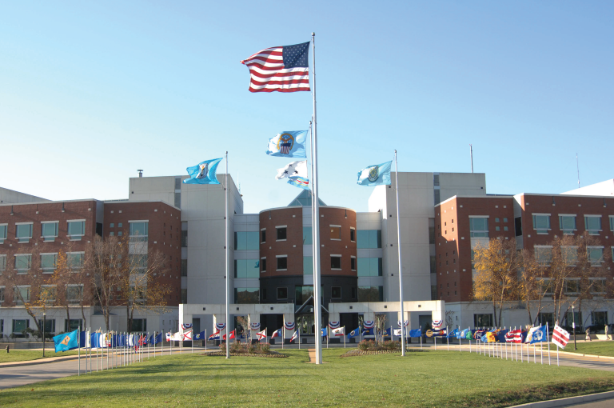
Selling to DLA
What does DLA buy?
Food, fuel, medical equipment
How does DLA buy from you?
DLA Internet Bid Board System (DIBBS)
Check DLA website for details
Register as a Government Contractor
SAM.gov to get UEI and CAGE Code
Register in DLA Supplier Portal: https://www.dla.mil/Vendor-Information-Hub/
Register as SDVOSB/VSOB/WO/8a on SBA website
Register for Wide Area Workflow (https://piee.eb.mil)
Identify the opportunities
DIBBS/SAMS/FPDS/DLA Procurement Forecasts
Leverage SBA/DLA Small Business Office/Set-Asides
Consider
CMMC requirements
MILSPEC requirements
ISO Certifications

Slide 19
Possible Procurement Changes?
Faster
Simpler
More OTAs and other fast-track initiatives
Focus on Innovation/Technology
Cyber, AI, Space, Quantum Computing, advanced manufacturing
More Data and AI in awards
Automated contracting
Cost control and accountability
More competition
Less sole-source contracts
More opportunity for newcomers

Slide 20
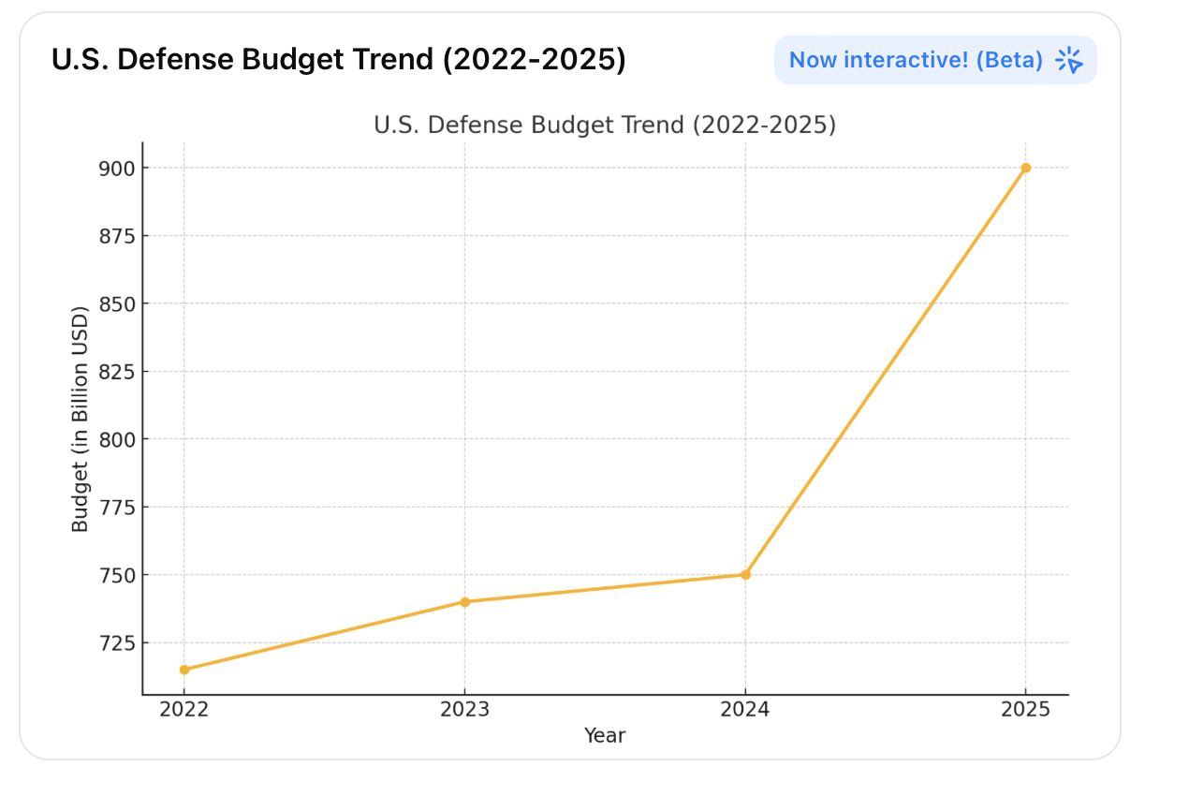
2025 Budget?
House Plan
Tax Cuts: $4.5 Trillion
Spending Cuts
Focus on non-defense Discretionary
Reforms to Medicaid, food assistance
Increase Debt Ceiling: $4 Trillion
Border Security Enhancements for CBP and ICE
Defense increases : $150 Billion
Cyber/Emerging Tech: $40 Billion
MILPERS pay: $25 Billion
Adv Wpns/Modern: $50 Billion
Border Security: $15 Billion
Senate Plan
$150 Billion added to Defense over 4 years
Mostly Navy Shipbuilding
$20 Billion for USCG

Slide 21
Questions

Slide 22
What does DLA Buy?
1. Aviation & Aerospace Parts
Aircraft components (engines, landing gear, avionics)
Repair parts and maintenance equipment
Flight safety equipment
2. Land & Maritime Equipment
Tactical and combat vehicle parts
Ship and submarine components
Ground support and heavy machinery
3. Weapons Systems & Ammunition
Small arms parts and accessories
Missiles and munitions components
Firearms maintenance supplies
4. Energy & Fuel
Jet fuel (JP-8, JP-5, AVGAS)
Diesel and gasoline for military vehicles
Alternative fuels and energy solutions
5. Clothing, Textiles & Personal Gear
Military uniforms and boots
Tactical gear (helmets, gloves, body armor)
Cold-weather and flame-resistant clothing
6. Medical & Pharmaceutical Supplies
Medicines and vaccines
Medical equipment (ventilators, surgical tools)
Field hospital and combat casualty supplies
7. Food & Subsistence
Meals Ready-to-Eat (MREs)
Fresh and frozen food supplies
Bulk rations for military operations
8. Construction & Infrastructure Materials
Lumber, concrete, and metal
Generators and power equipment
HVAC and plumbing supplies
9. IT & Communications Equipment
Computers, servers, and cybersecurity tools
Radios and satellite communication systems
Software and networking equipment
10. Office Supplies & Industrial Hardware
Paper, printers, and office furniture
Hand tools, fasteners, and safety gear
Storage containers and shelving

